Slide 1

Electrical Engineering Capstone
Condition Monitoring of Electrical Machines Using IoT
Created By Agya Aboagye-Otchere & Edem Bleboo
Supervised By Dr. Stephen K. Armah and Dr. Robert Sowah

Slide 2
Outline
1
1. Introduction and Background
2
2. Design choices
Introduction and Background
Sensor choice and placement, Flow Diagram
3
3. Design methodology
4
4. Data Communication And Storage
Design methodology
Data Communication And Storage
5
5. Data Collection, Analysis and Results
6
6. Conclusion
Achievements and Future Works
Data Collection, Analysis and Results

Slide 3
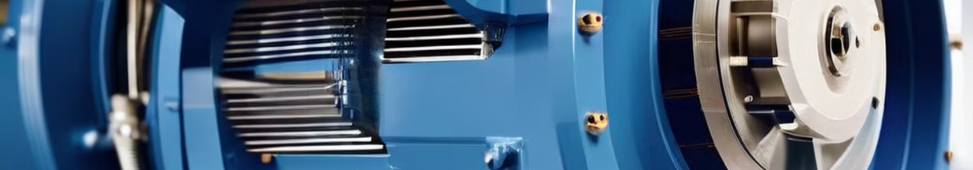
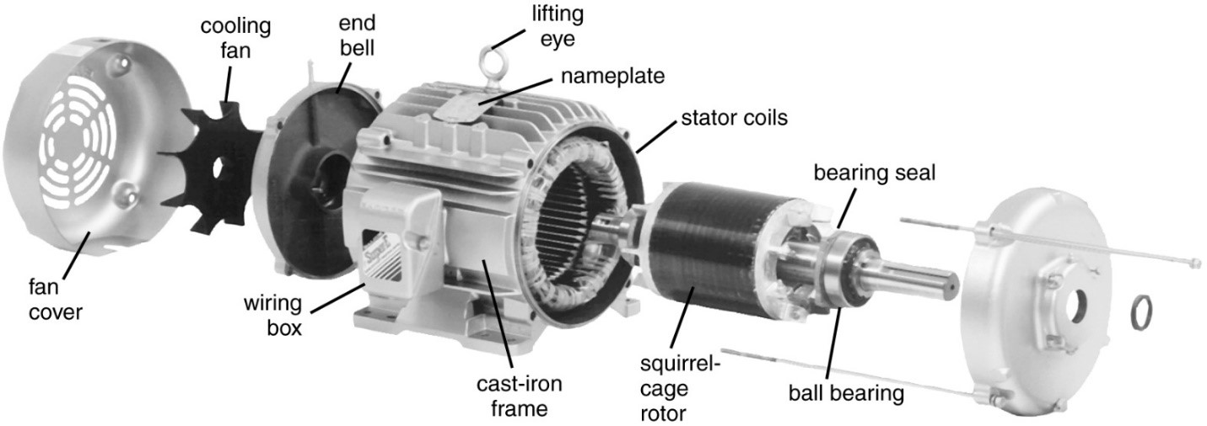
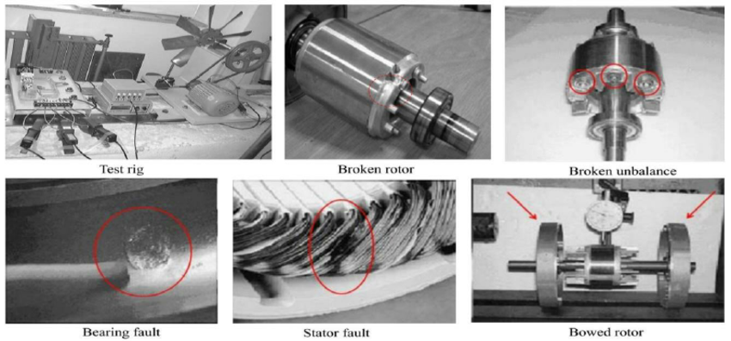
Introduction
Electrical machines:
Induction motors faults:
Induction motors account for 85 % of all Industrial motors
Mechanical: Bearing faults, Shaft Misalignments,
Broken Rotor bar.
Electrical faults: Stator winding faults, Insulation failure.
Existing solutions:
Condition based maintenance:
Scheduled maintenance
Reactive maintenance
Real time
Key parameters

Slide 4
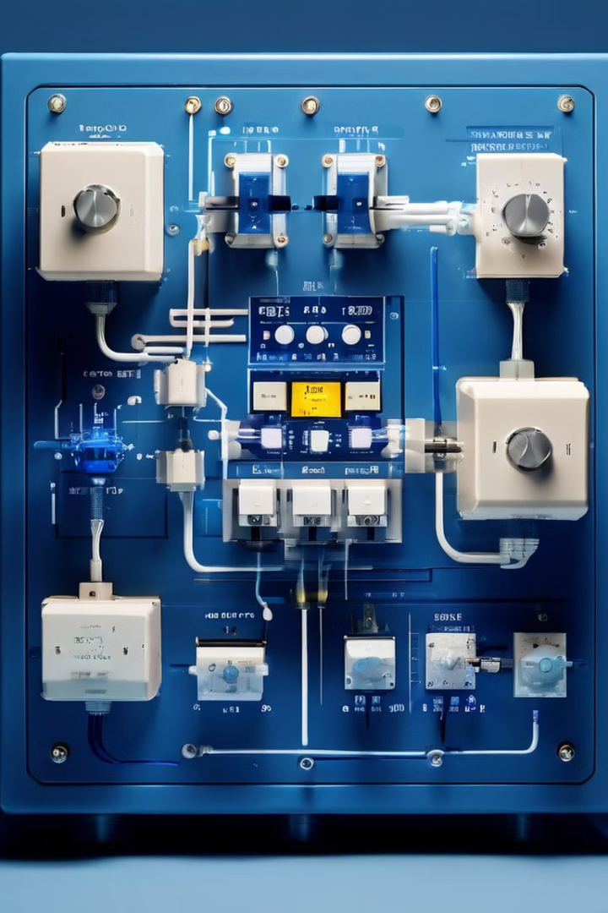

By using a network of sensors to monitor relevant motor attributes the state of a motor can be evaluated, and early maintenance can be performed to extend motor life.
PROPOSED SOLUTION
Condition Monitoring

Slide 5

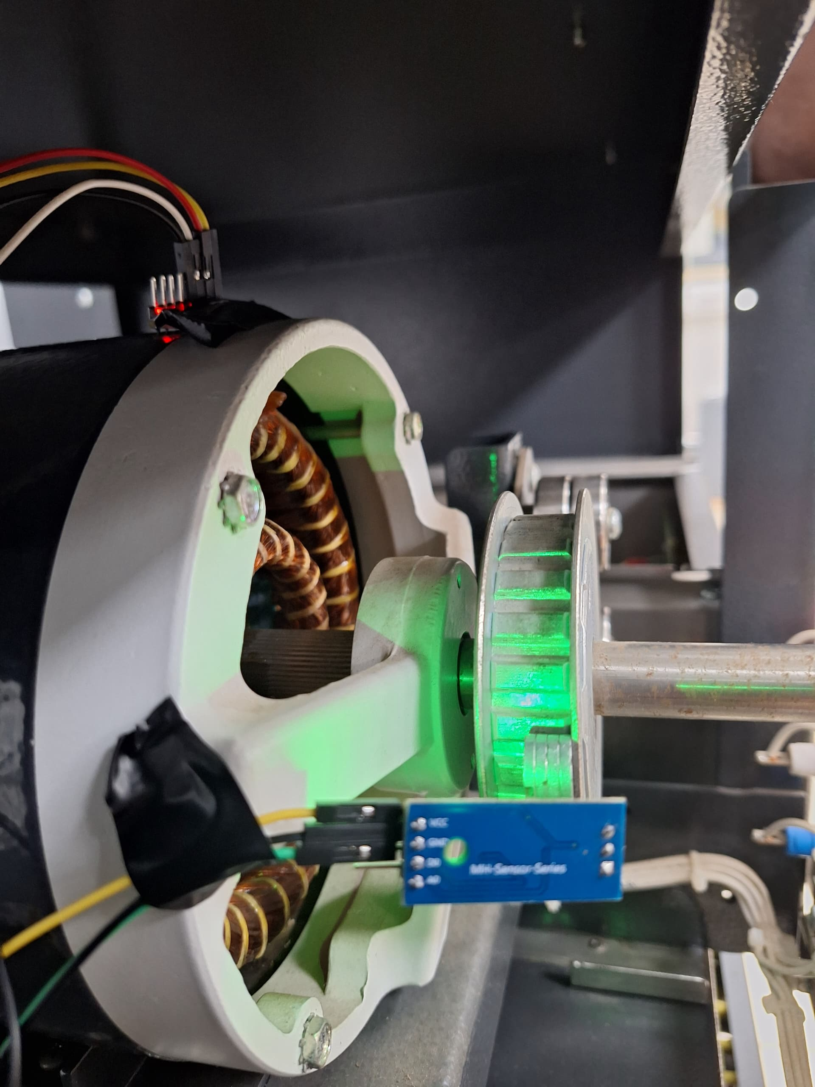
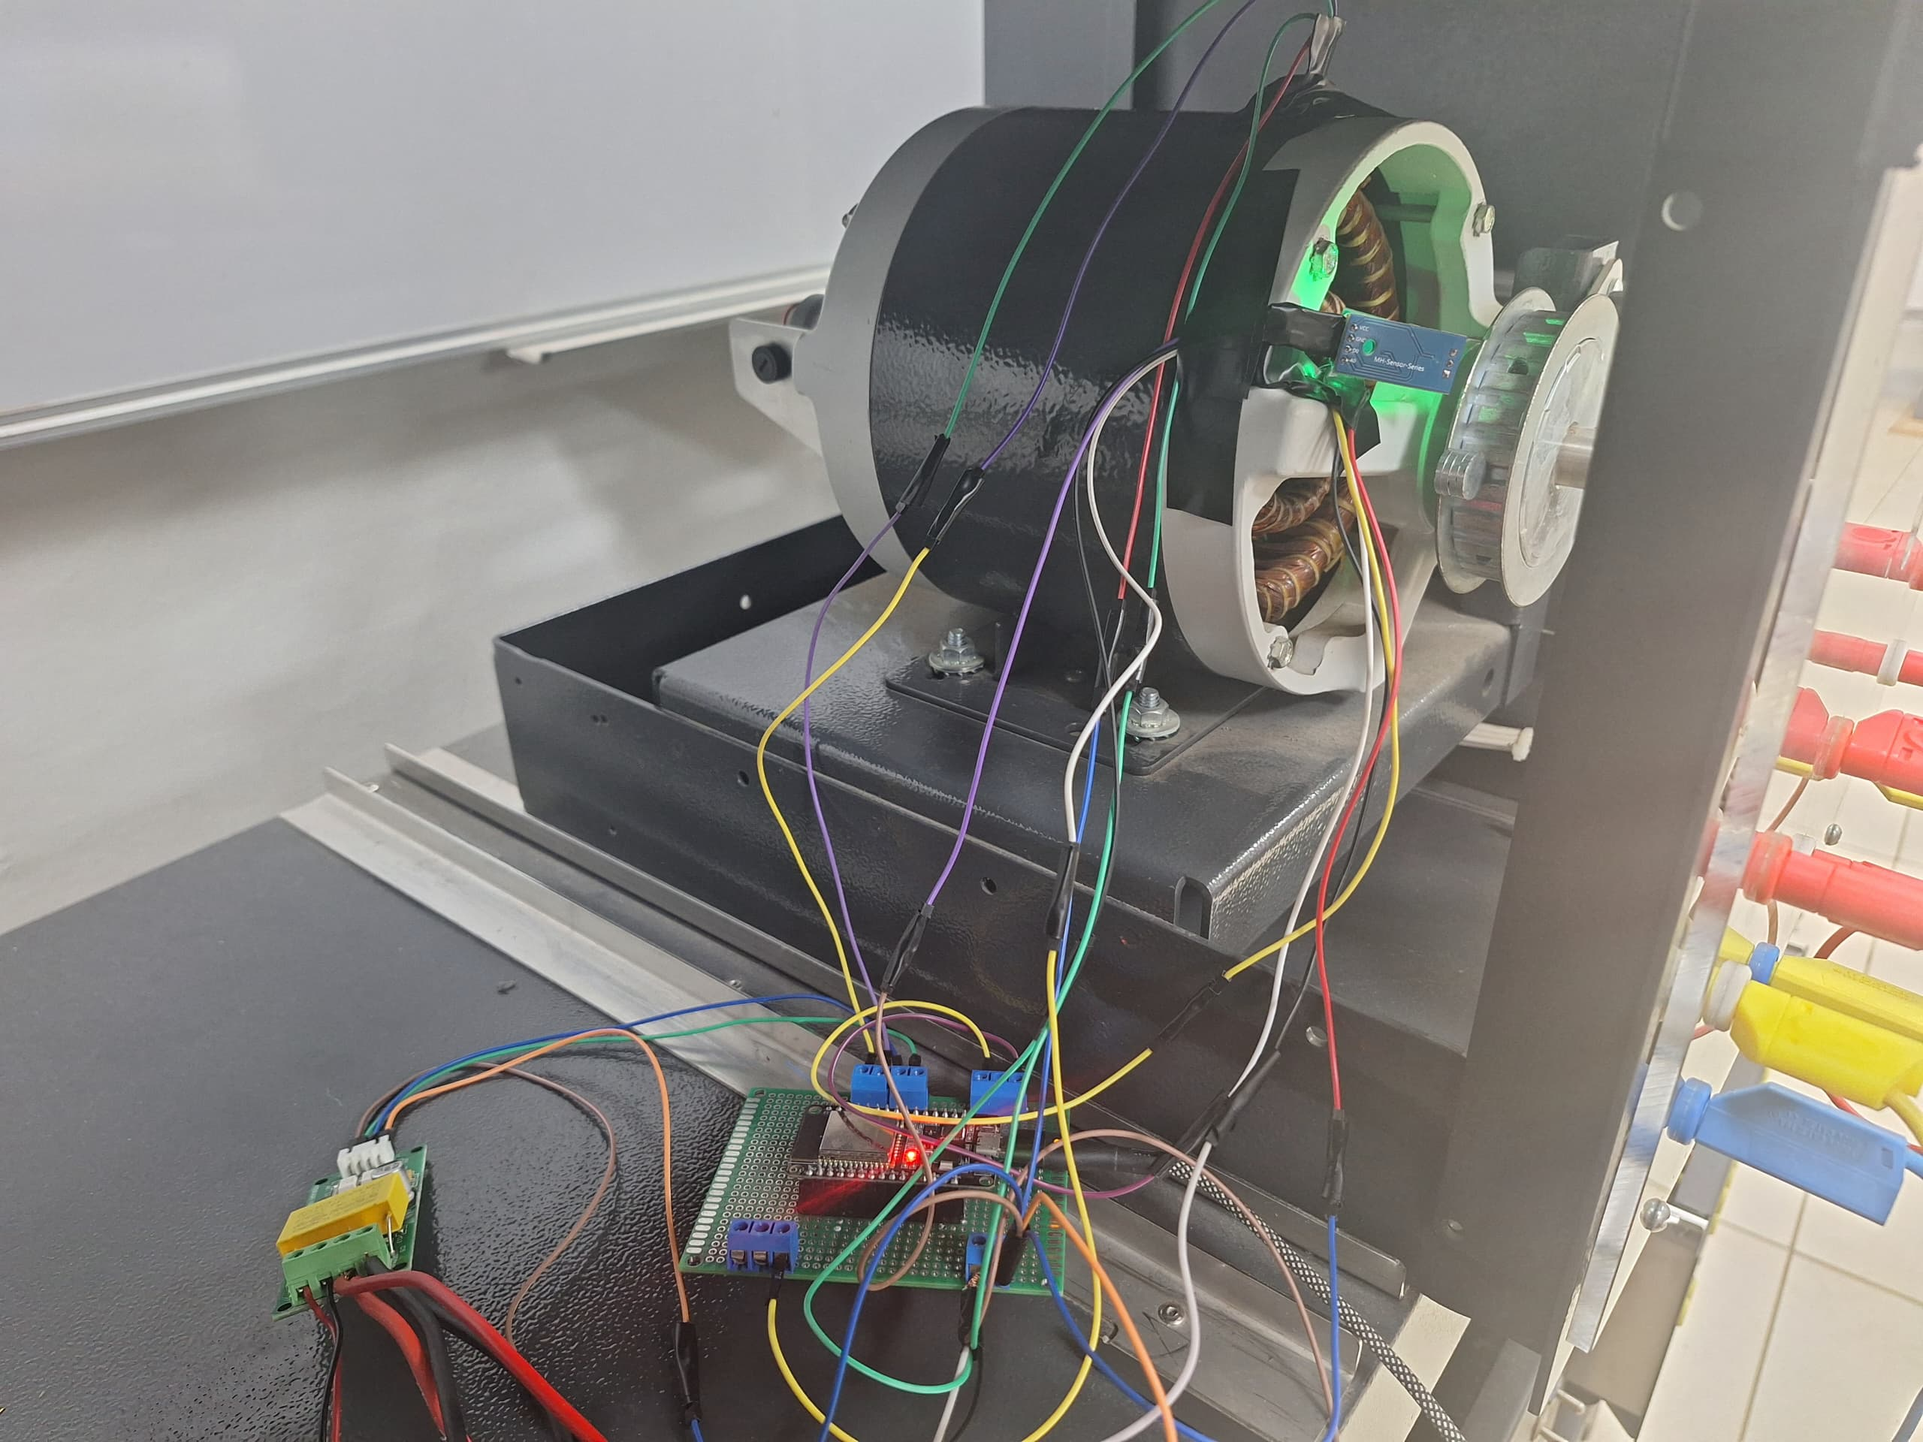
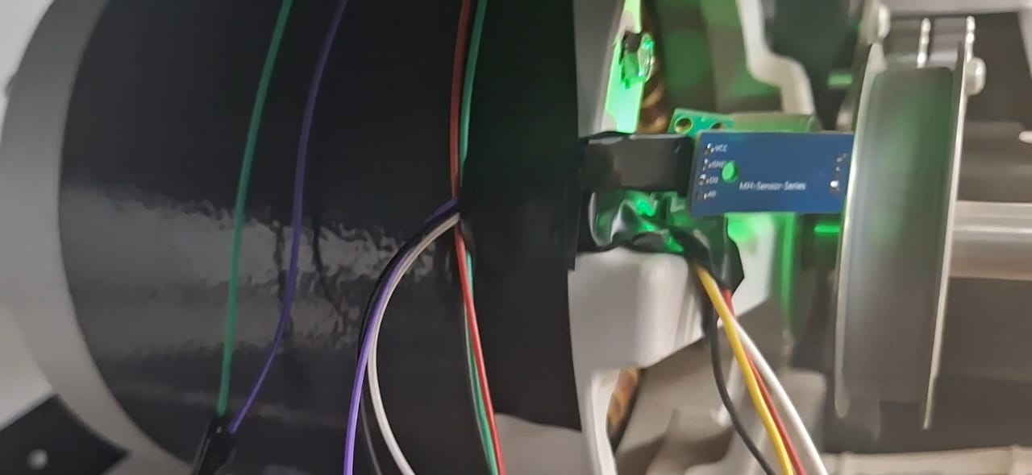
Design choices
Sensor choice and placement:
MPU6050 Accelerometer
PZEM-004T sensor
GY906 infrared thermometer
Digital Hall effect sensor

Slide 6
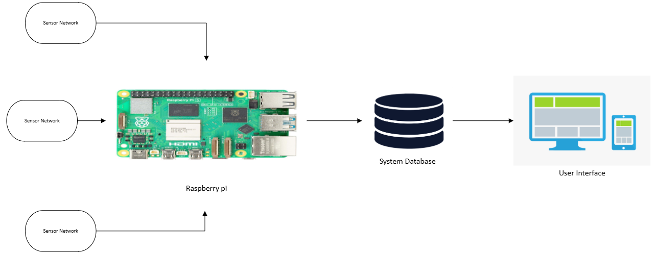
Design Methodology
1
Sensors
The multi-sensor module collects data from the motor.
2
ESP32
The ESP32 processes the data and sends it to the Raspberry Pi.
3
Raspberry Pi
The Raspberry Pi receives the data, sorts it, and sends it to
the database.
4
Database
The database stores the data for analysis and visualization.

Slide 7
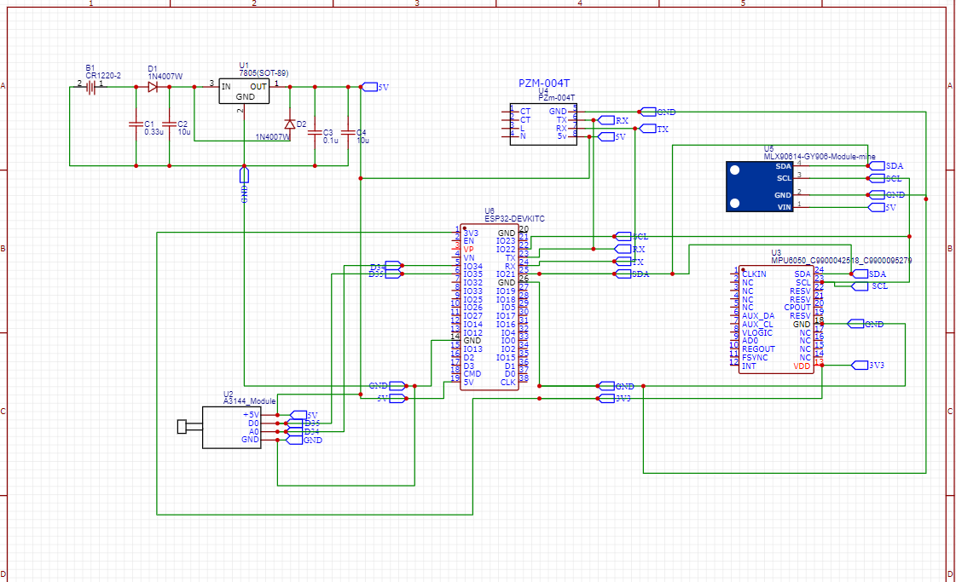
Circuit Schematic

Slide 8
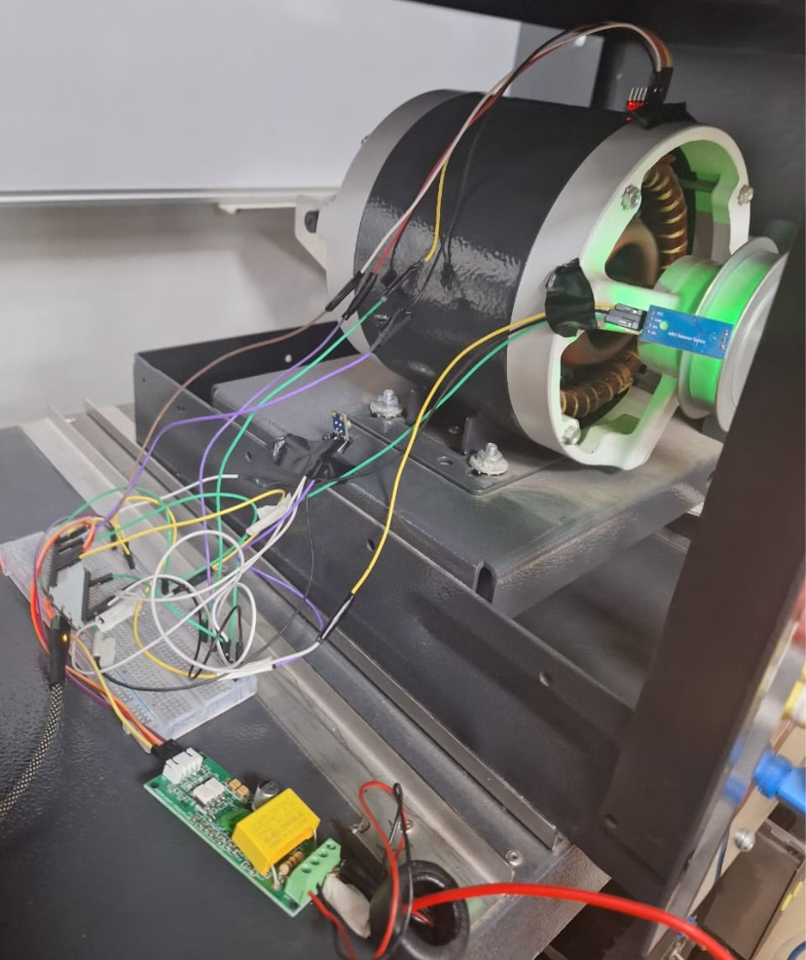
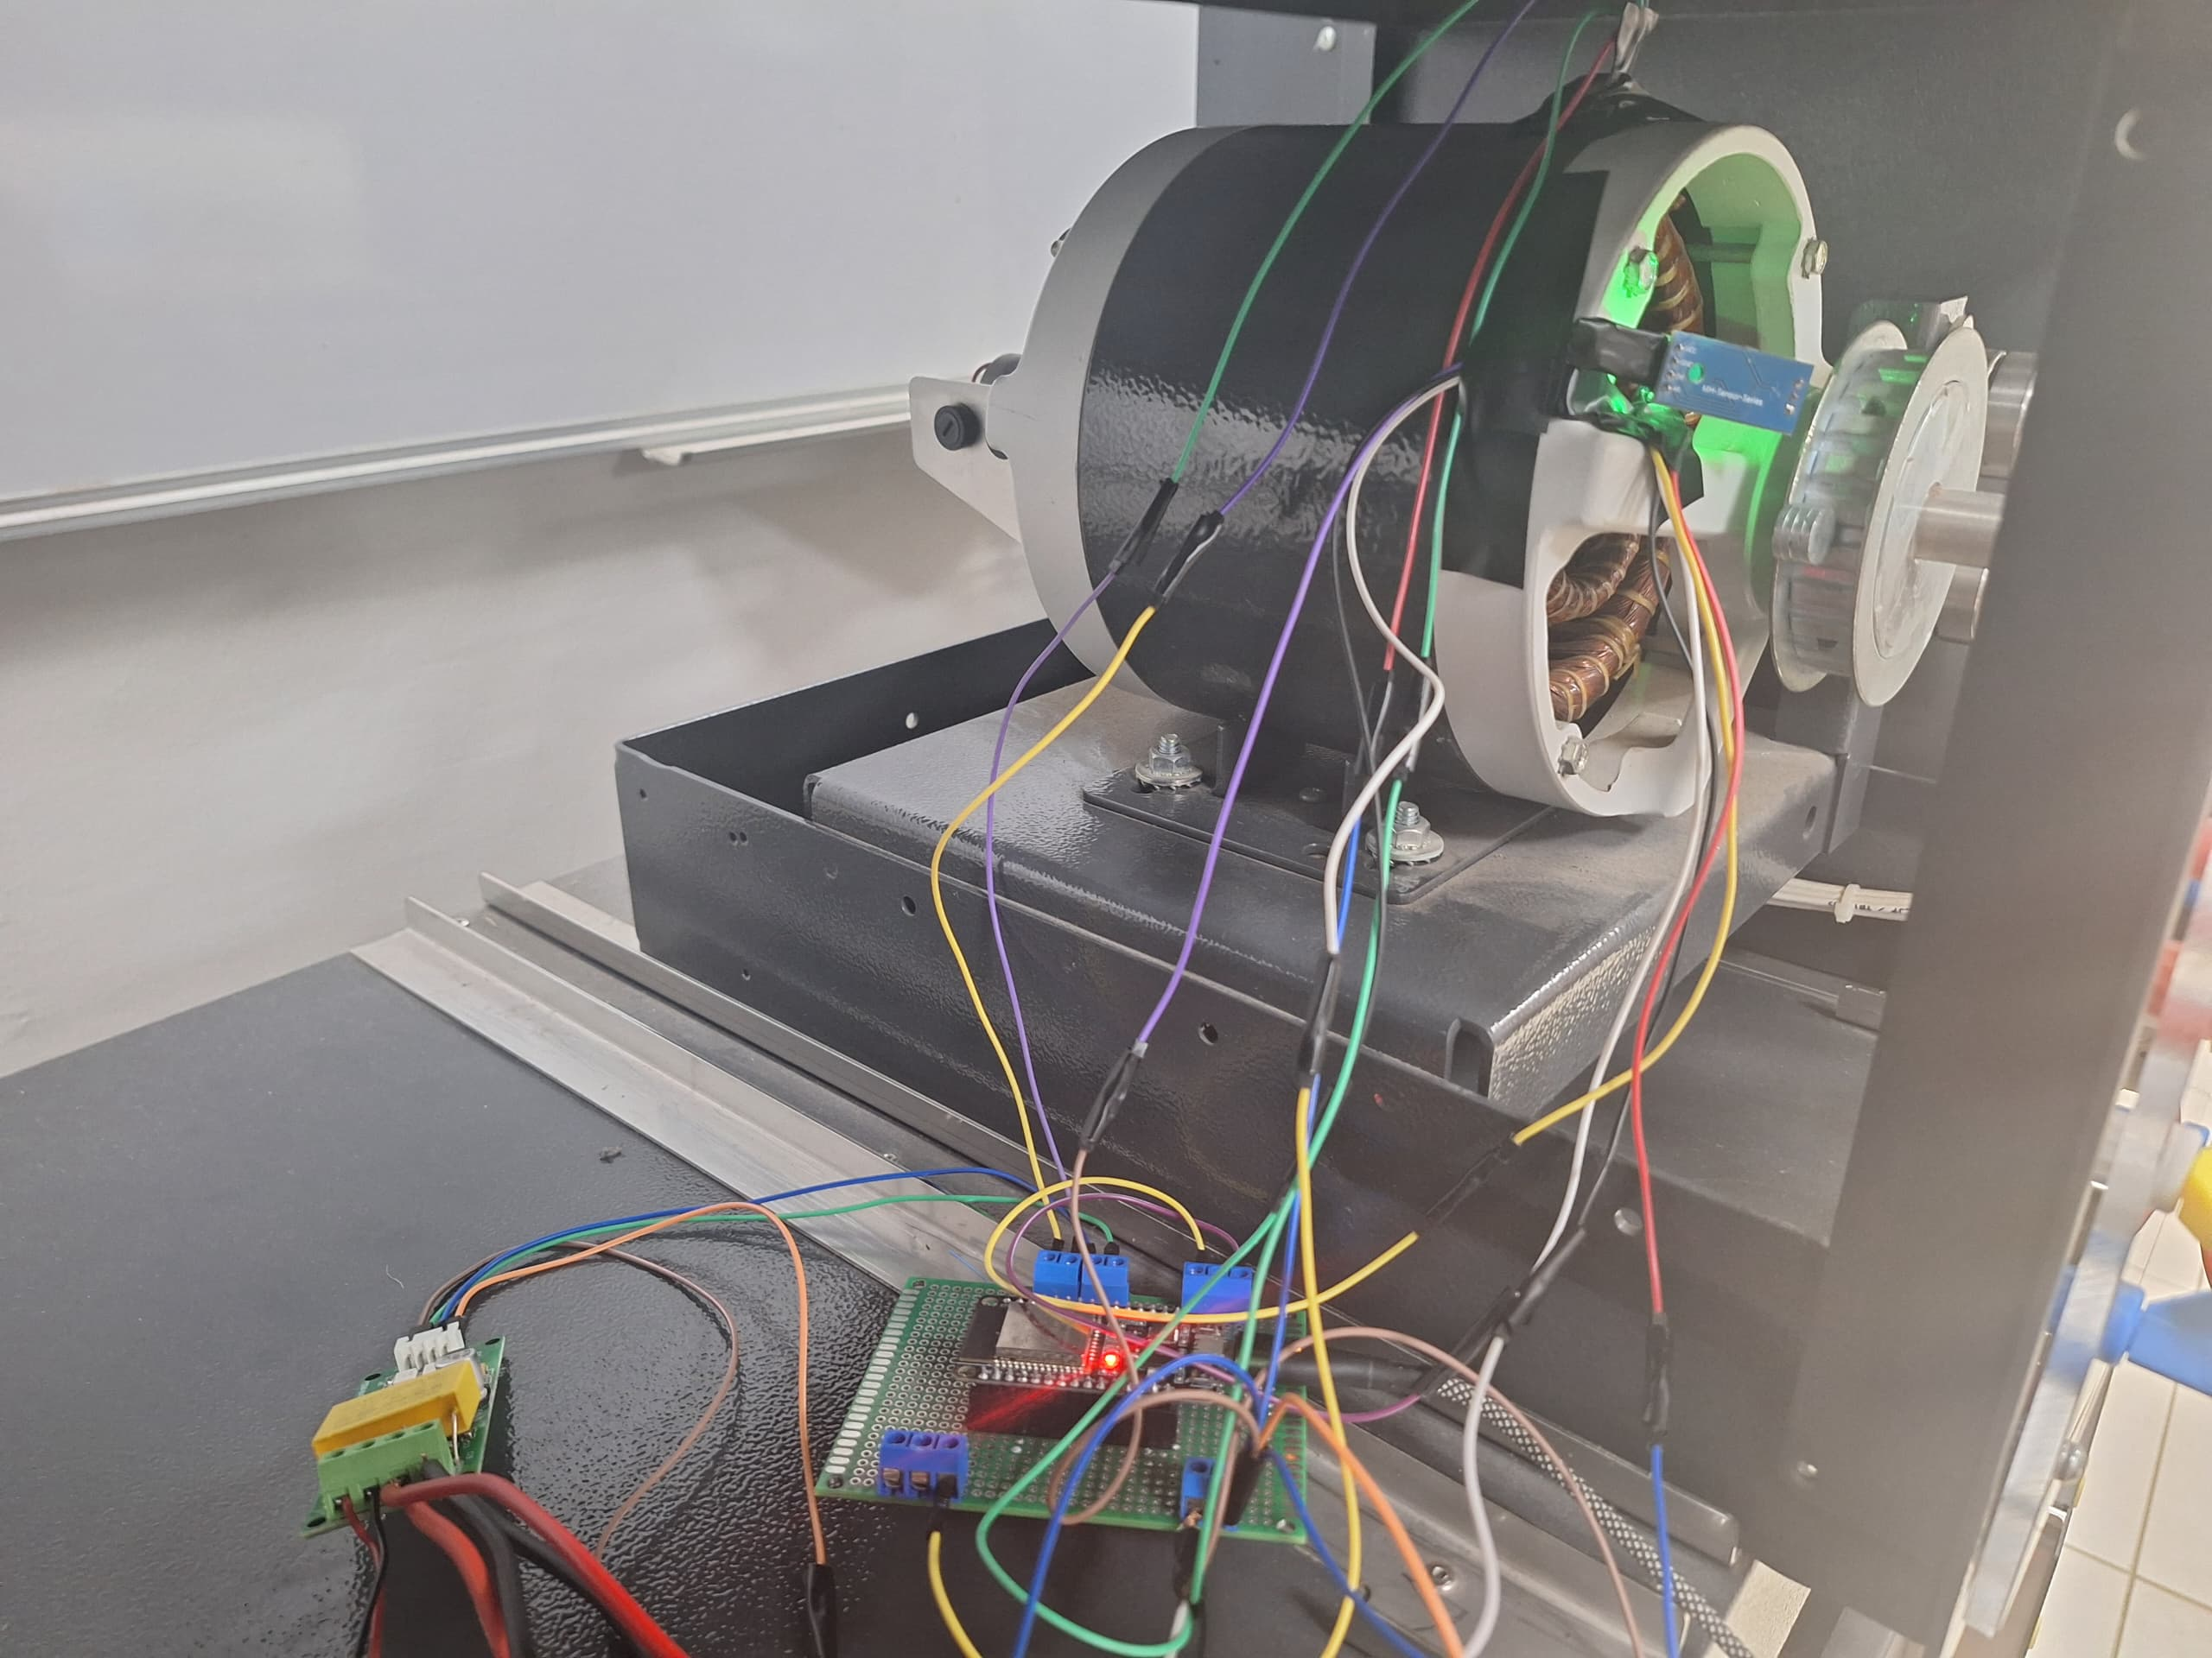
Physical Implementation
Initial design with bread board
Design with perforated board

Slide 9
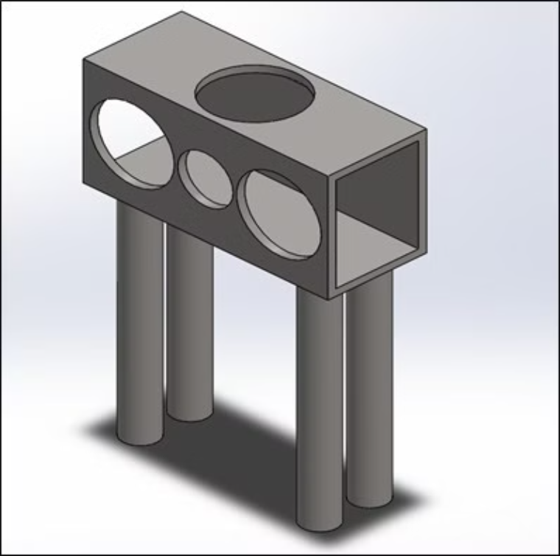
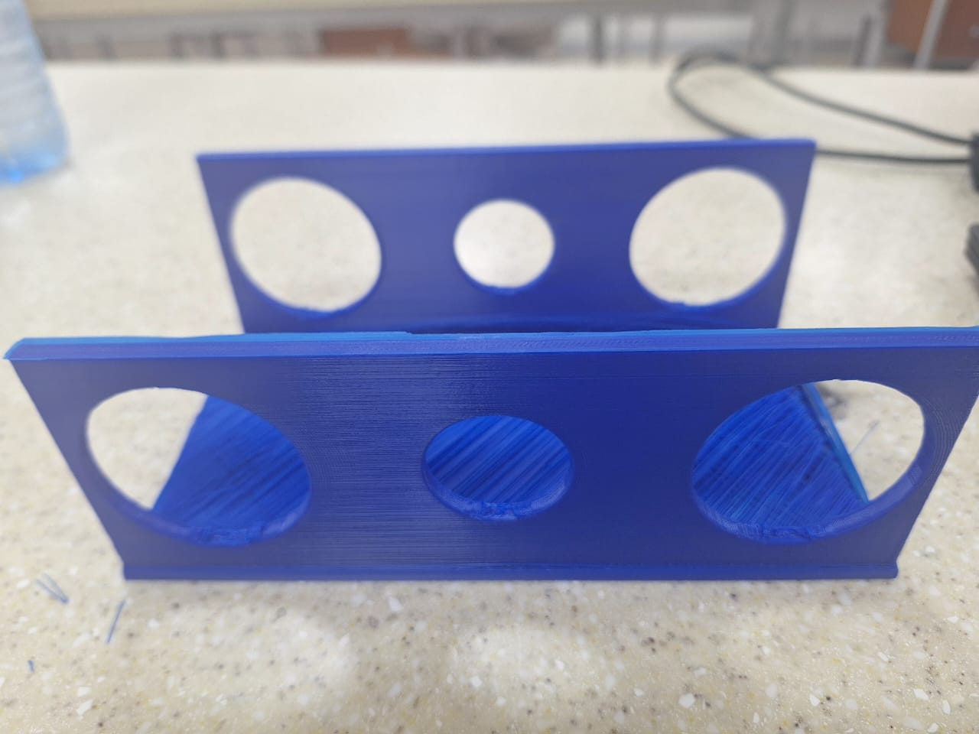
Electrical housing
3D design is SolidWorks
3D printed desing

Slide 10
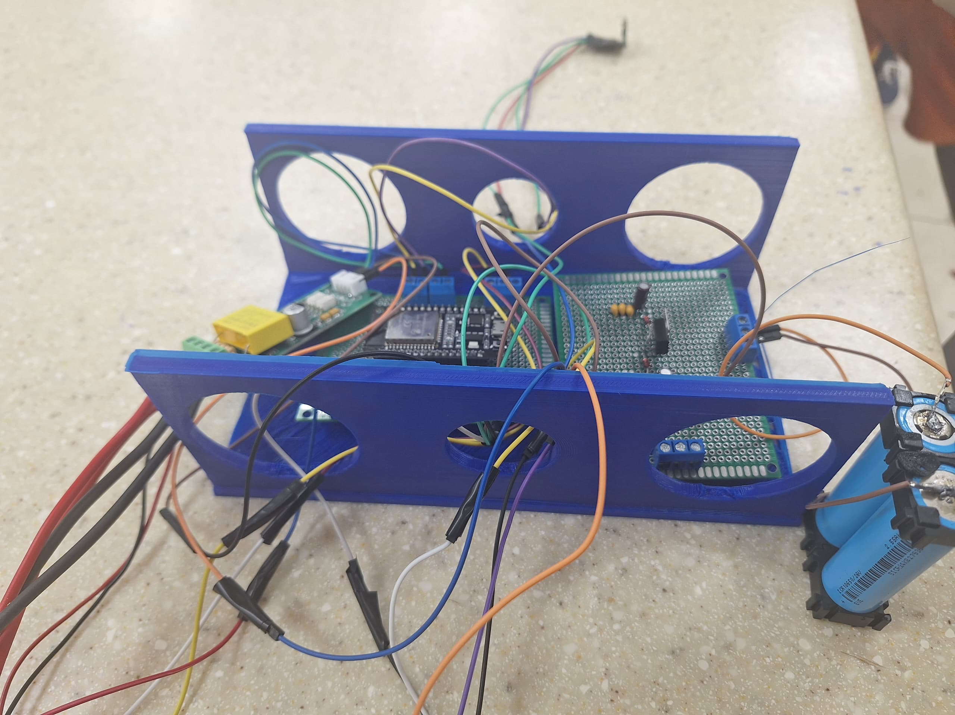
Final Setup
Electrical housing
ESP32
Network of Sensors
Battery Supply

Slide 11
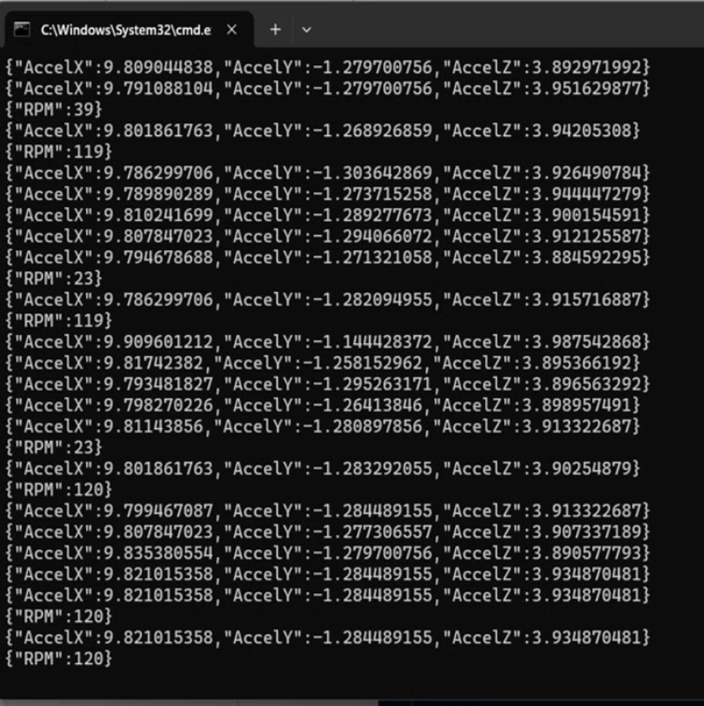
Data Communication
The communication protocol for the system is MQTT.
MQTT offers a lightweight, low-bandwidth protocol used in IoT. It works using a publisher-subscriber model and provides greater scalability for IoT applications
The raspberry pi acts as the server that receives data from numerous multi-sensor modules, sorts them and posts to our database

Slide 12
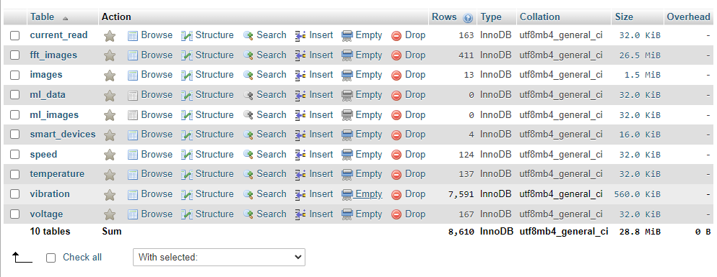
Data Storage
Data from several devices are stored in an SQL database designed to efficiently handle data for multiple devices with several sensors.

Slide 13
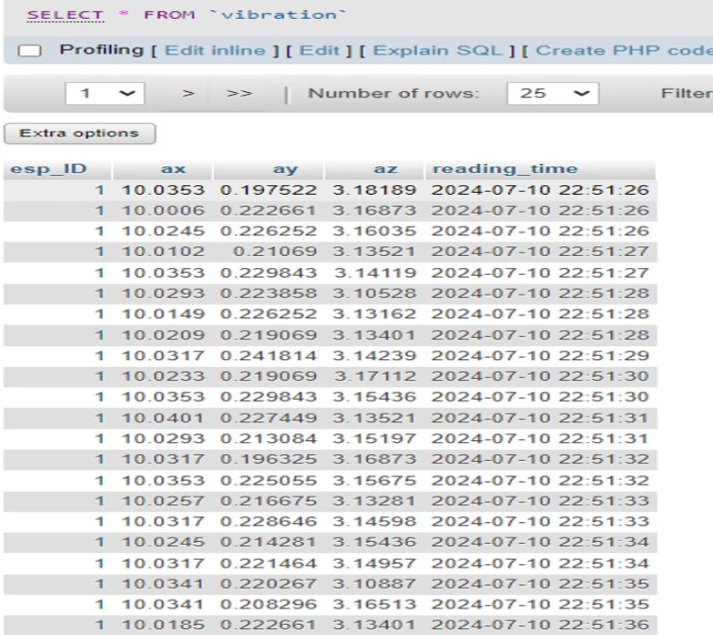
Data Storage
An API was developed to post data to each table in the database based on the required parameters.
The API required an ID for incoming data so that they can be identified and processed.

Slide 14
Data Collection Process
Vibration Capture
1
Vibration data was collected at a high sampling rate of 1 kHz to accurately capture the motor's dynamic behavior and avoid aliasing.
2
Speed Monitoring
Speed changes are relatively slow, so the system captured speed data at a lower 100 Hz rate to balance performance and data resolution.
Electrical Measurements
3
Current and voltage were sampled at 2 Hz due to the limitations of the PZEM-004T sensor, providing useful electrical profiles.
4
Thermal Imaging
Thermal images were captured once per minute to monitor temperature changes, a slower variable that does not require high-speed sampling.

Slide 15
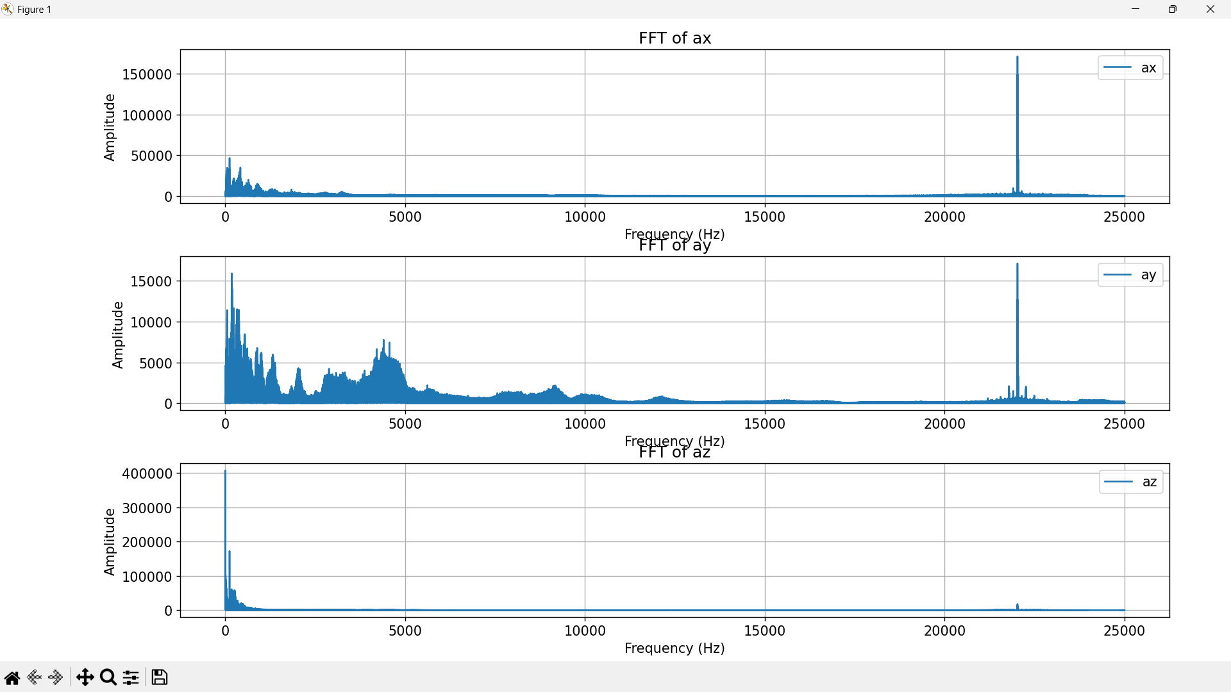
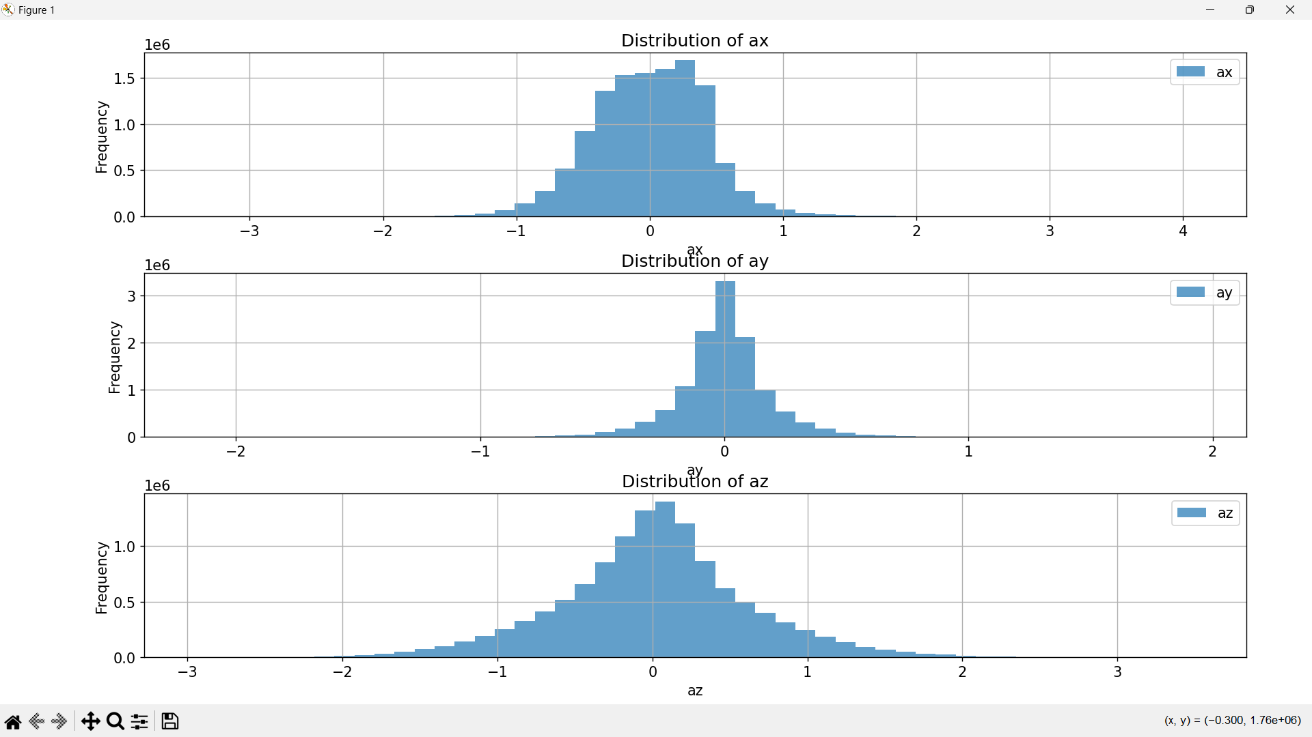
Simple Fault Detection System
Normal healthy motor data collection from accelerometer.
Data transformed from time domain to frequency domain (FFT analysis)
Statistical analysis and Normal distribution data displayed.
FFT results set as the baseline.

Slide 16
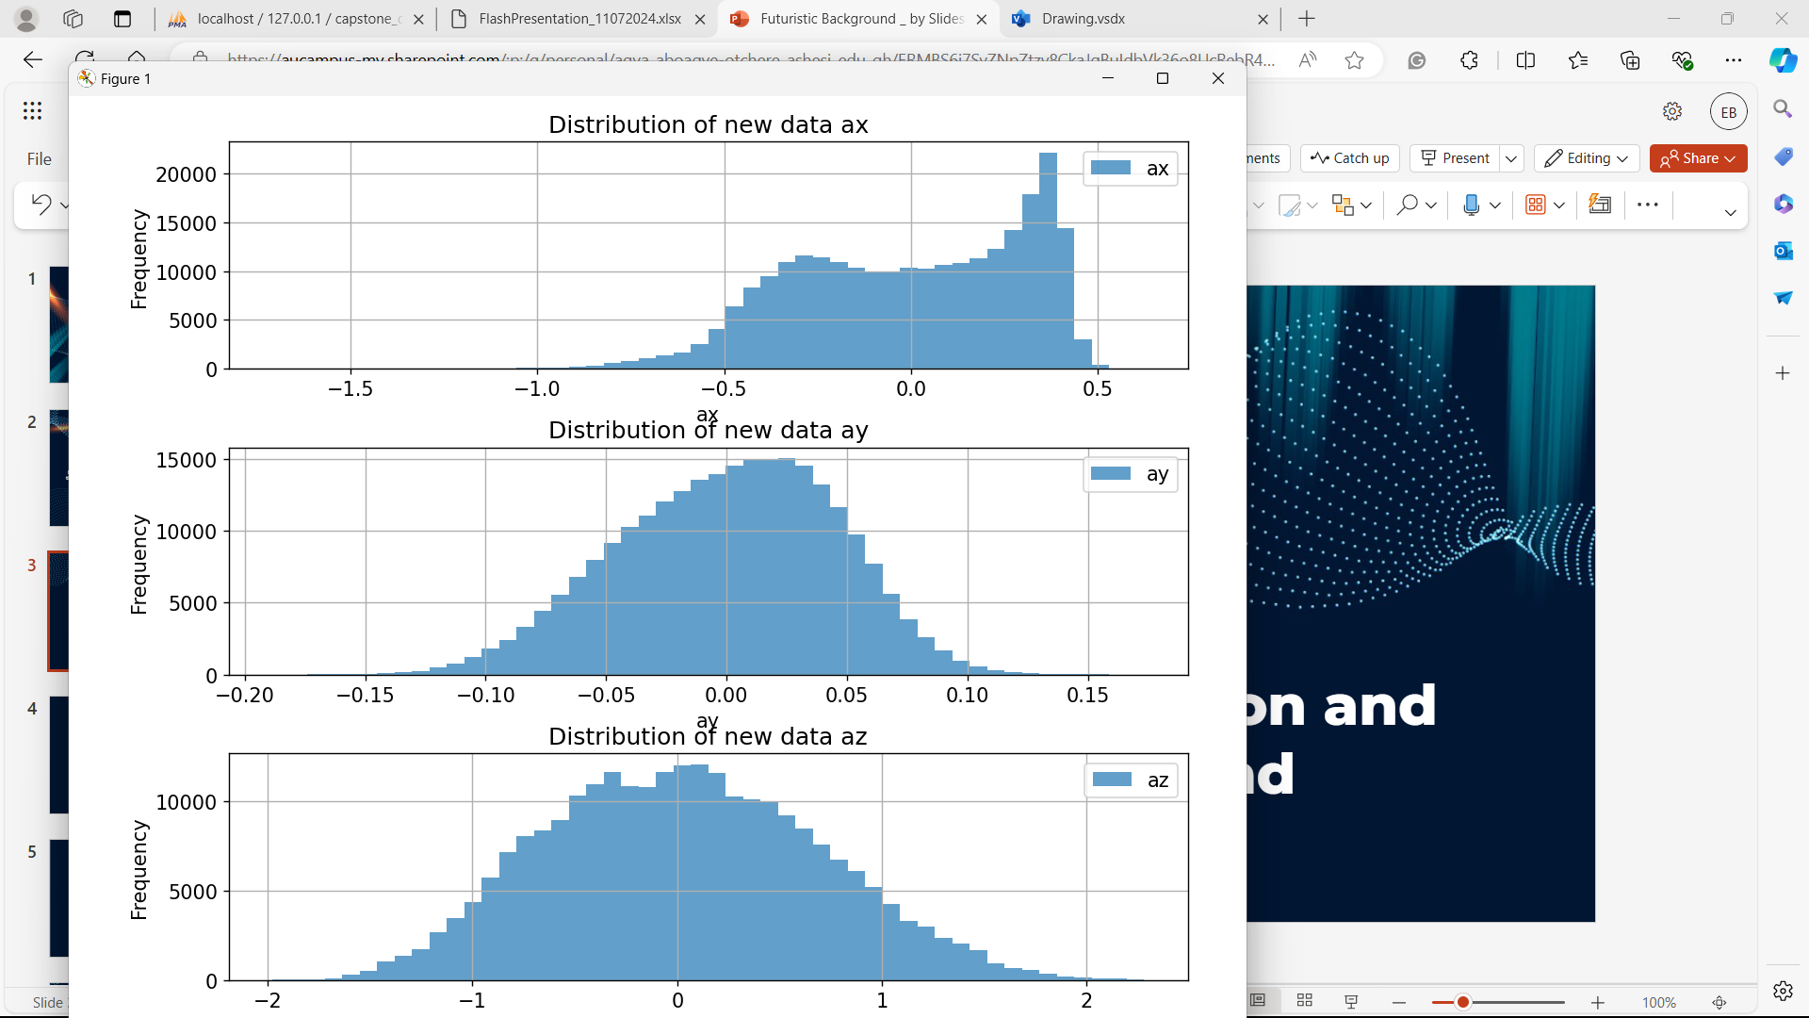
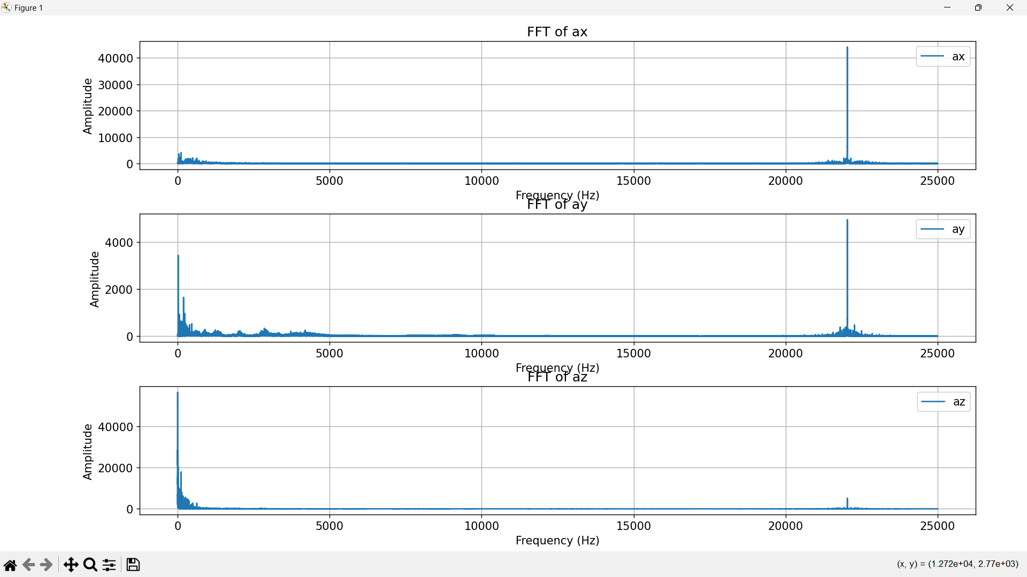
Simple Fault Detection System
New data collected from accelerometer.
FFT performed on new data
Statistical analysis and Normal distribution data displayed.
Mean amplitude and distribution data is compared with baseline using T and KS tests.
System identifies and prints out whether the motor is healthy or faulty.

Slide 17
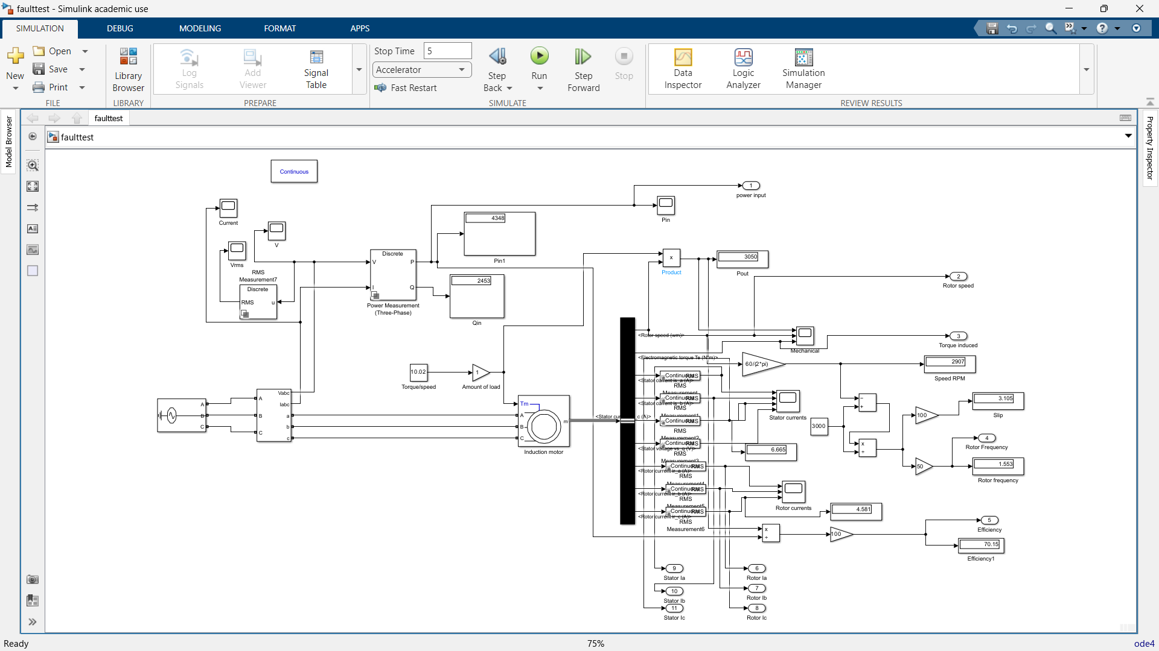
SIMULINK MODEL
Induction motor model designed on SIMULINK

Slide 18
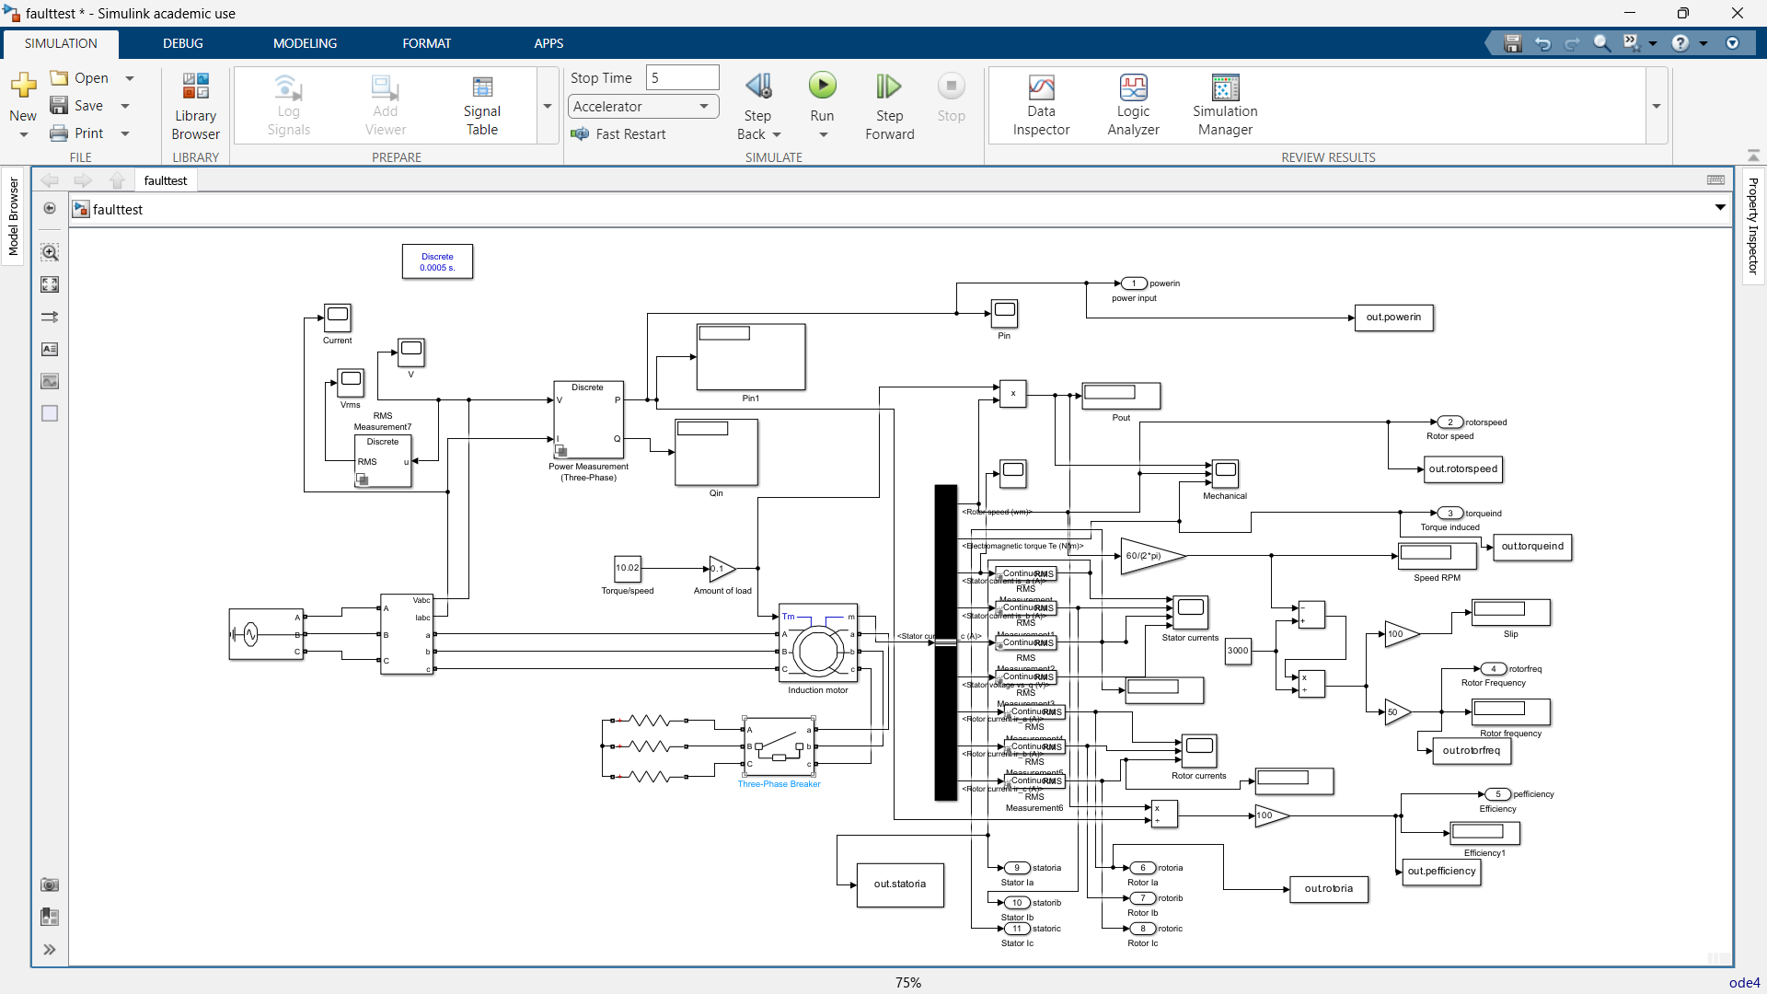
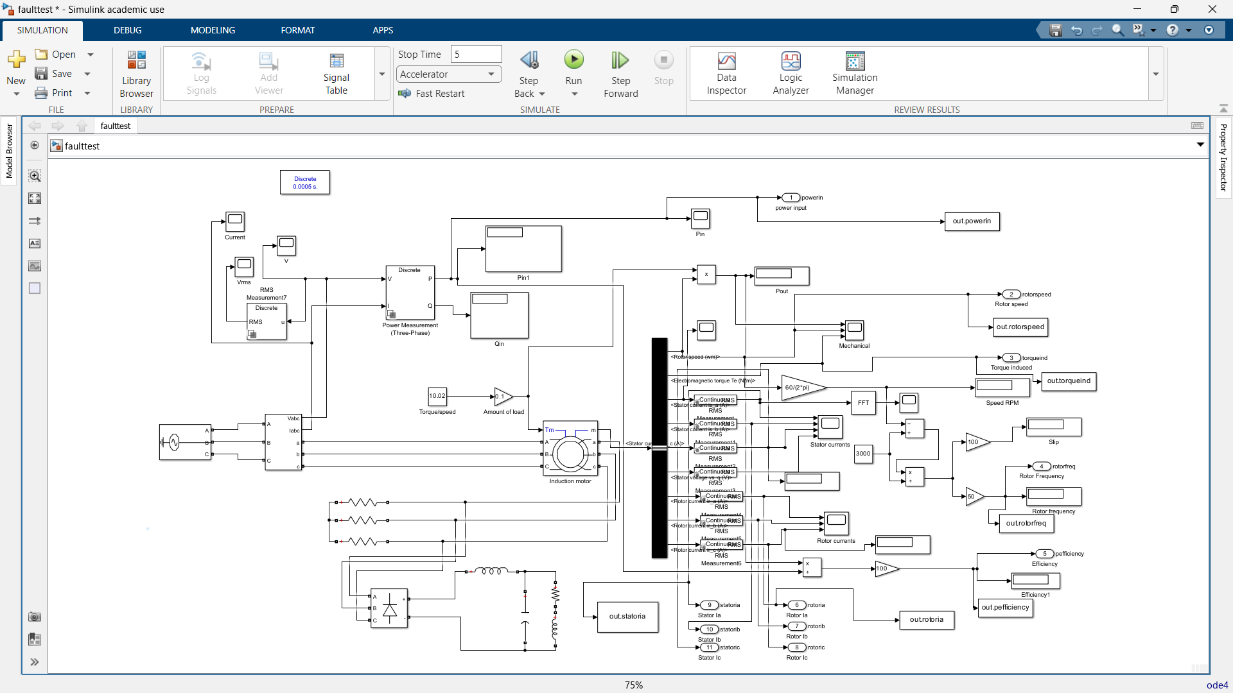
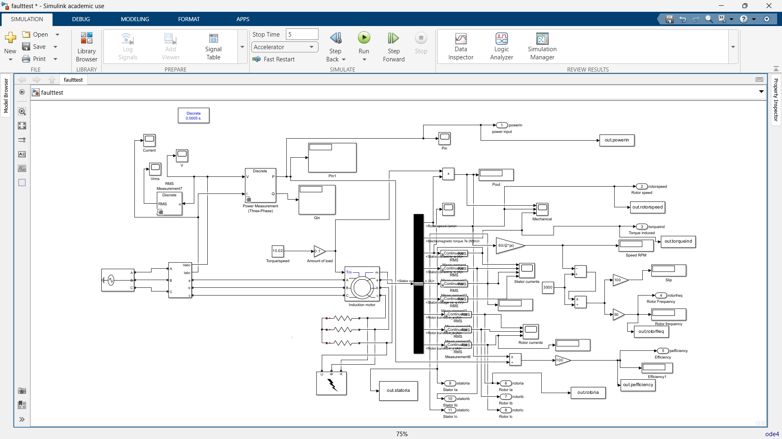
SIMULINK MODEL
Open Circuit fault
Simulink Model
Short circuit fault
Broken Rotor bar

Slide 19
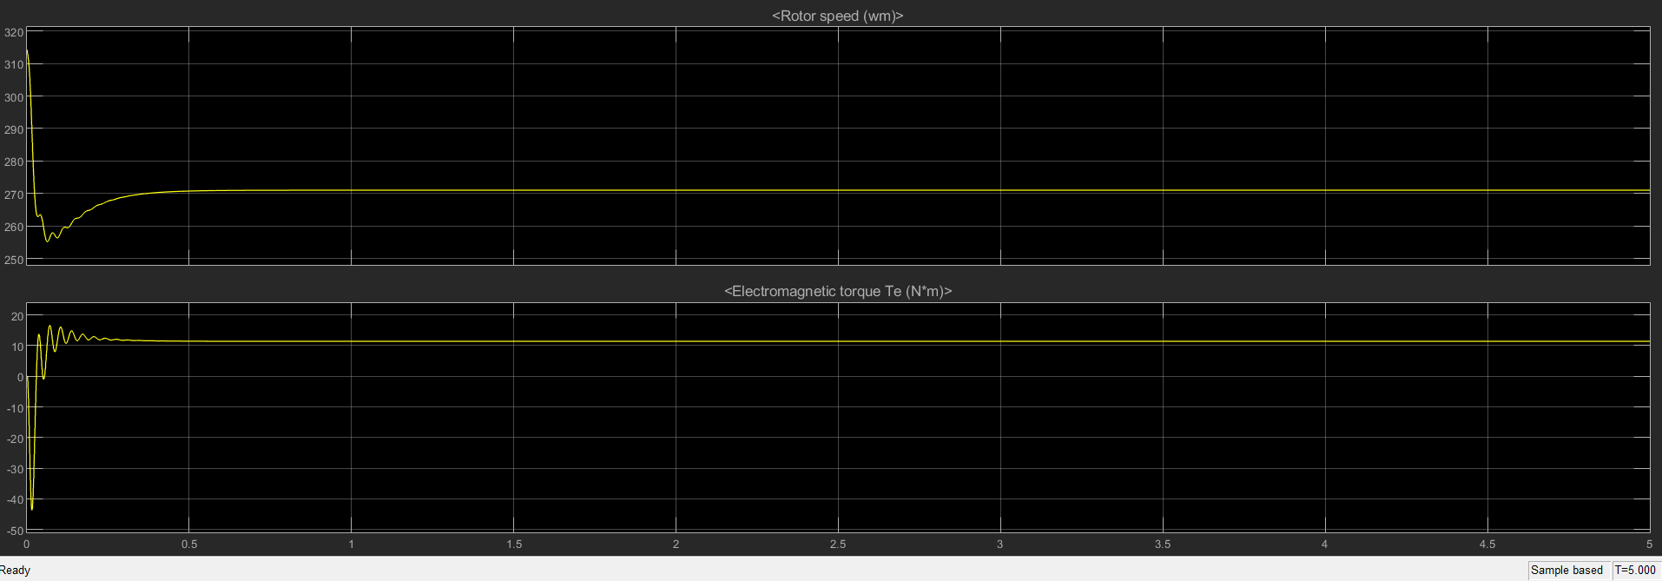
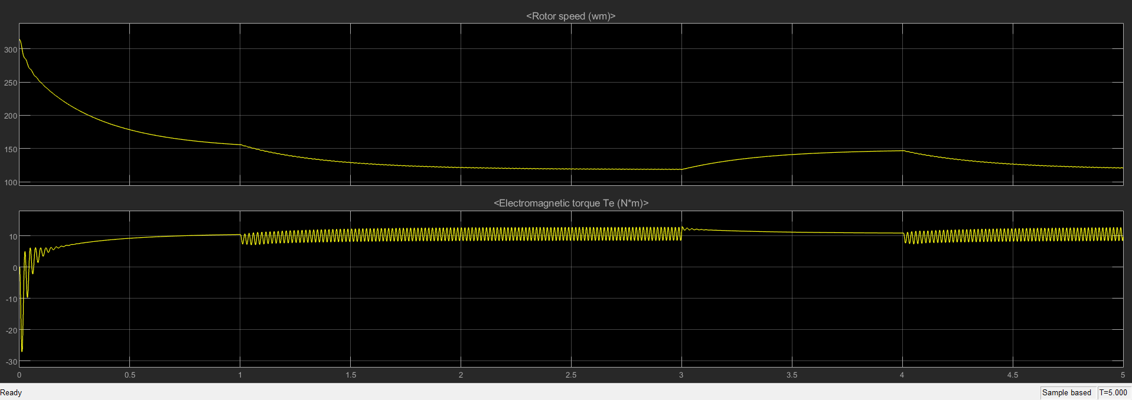
Open Circuit Fault
Torque and speed of healthy motor
Torque and speed of motor with open circuit fault

Slide 20
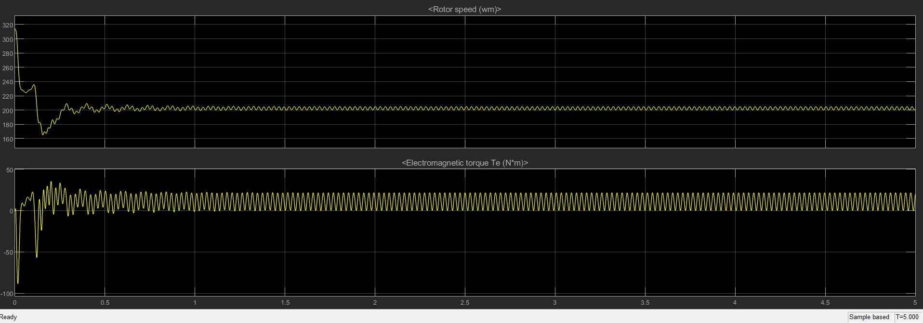
Short Circuit Fault
Torque and speed of healthy motor
Torque and speed of motor with short circuit fault

Slide 21
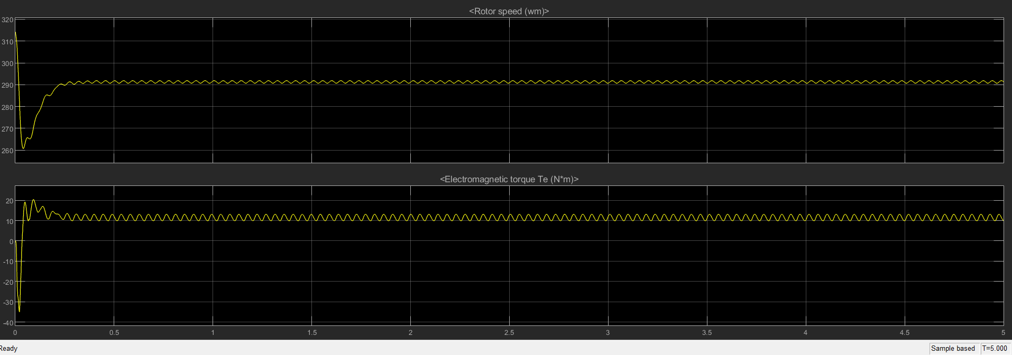
Broken Rotor Bar Fault
Torque and speed of healthy motor
Torque and speed of motor with broken rotor bar fault

Slide 22

Fault Classification
Model Selected: XGBoost Classification Model
This technique builds models sequentially.
It constructs decision trees that corrects the errors of other trees.
It can capture non-linear patterns and can handle missing data which made it suitable for this project.

Slide 23
Model Implementation
A butterworth filter was used to remove noise from the data
The data was cleaned and FFT was performed to extract dominant frequency domain characteristics.
Feature extraction was performed and the data was combined and labeled based on the faults under consideration.
The model was then trained and cross – validated using the XGBoost Model.

Slide 24
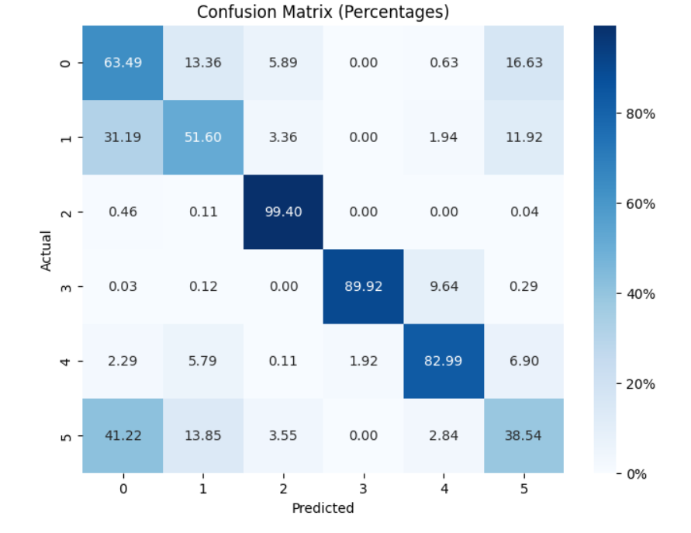
Machine Learning Classification
Motor States and Accuracy
0 – Normal Operation: 63.49%
1 - Imbalance Fault: 51%
2 – Vertical Misalignment Fault: 99.4%
3 – Horizontal Misalignment Fault: 89.92%
4 – Underhang Fault: 82.99%
5 – Overhang Fault: 38.4%
Overall Accuracy = 71.05%

Slide 25
ANN Model
The model is a neural network used for multi-class classification
Features used in this model were derived from the FFT of the vibration data.
There are 3 dense layers.
Layer 1: Rectified Linear unit which introduces non-linearity.
Layer 2: Batch Normalization to maintain normalized input
Layer 3: Dropout which prevented overfitting by randomly deactivating neurons

Slide 26
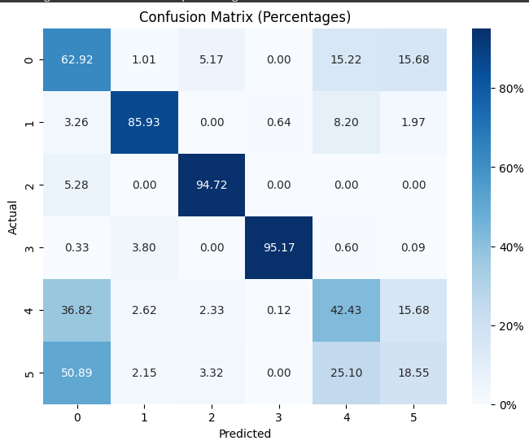
Machine Learning Classification
Motor States and Accuracy
0 – Normal Operation: 62.92%
1 - Imbalance Fault: 85.93%
2 – Vertical Misalignment Fault: 94.72%
3 – Horizontal Misalignment Fault: 95.17%
4 – Underhang Fault: 42.43%
5 – Overhang Fault: 18.55%
Overall accuracy = 66.63%

Slide 27

Website
A simple website was developed to explain the system and show results from the data collection and processing

Slide 28
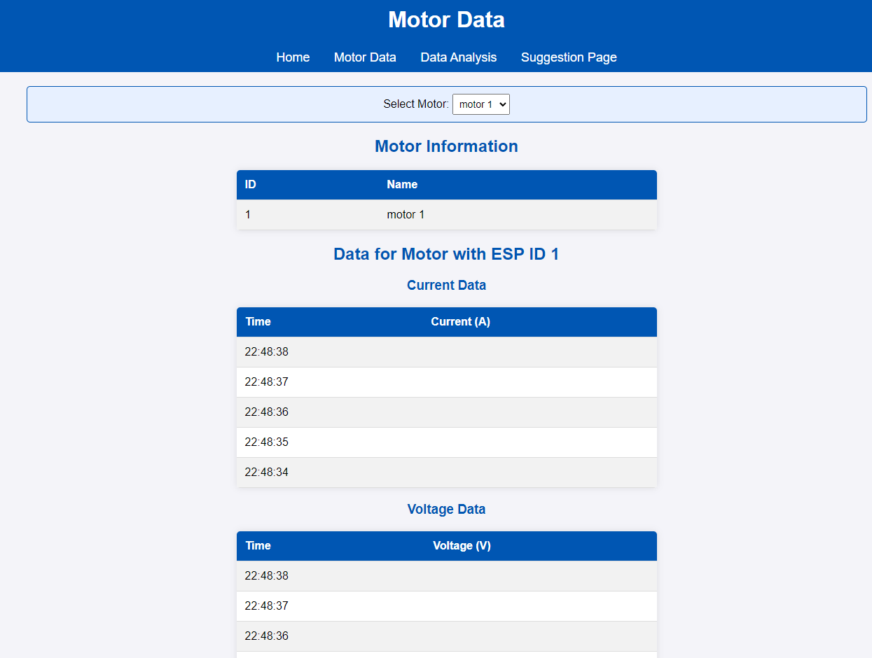
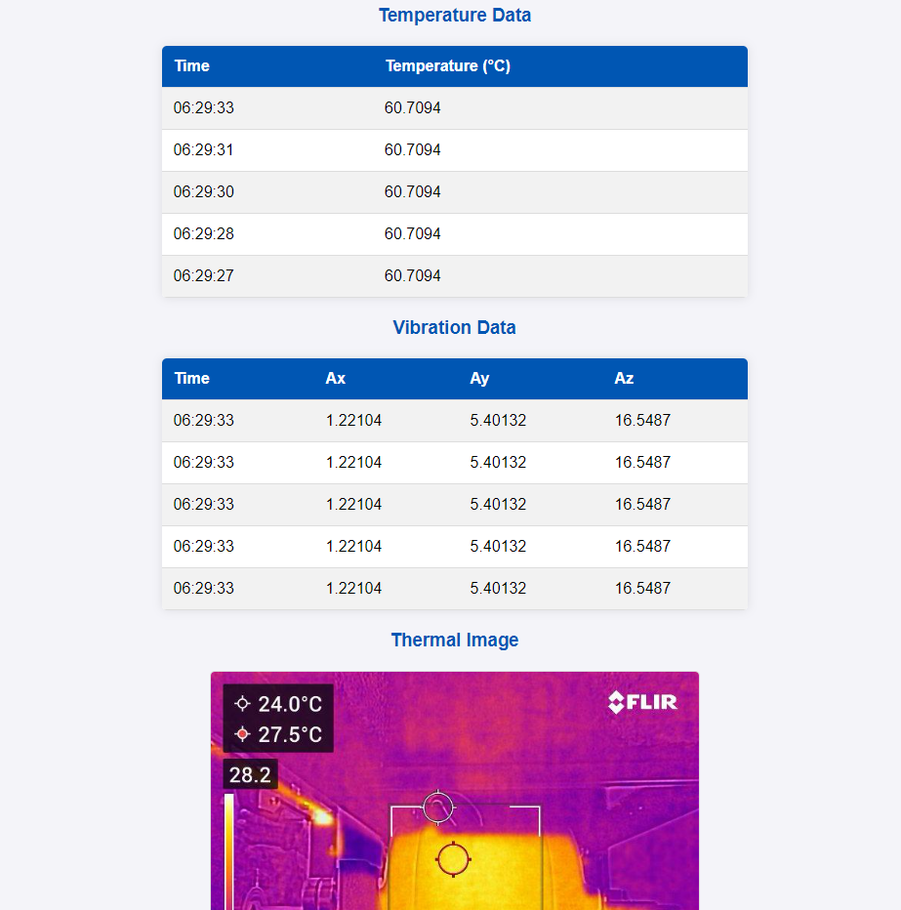
Motor Data Page
This page displays the data being recorded by the system

Slide 29
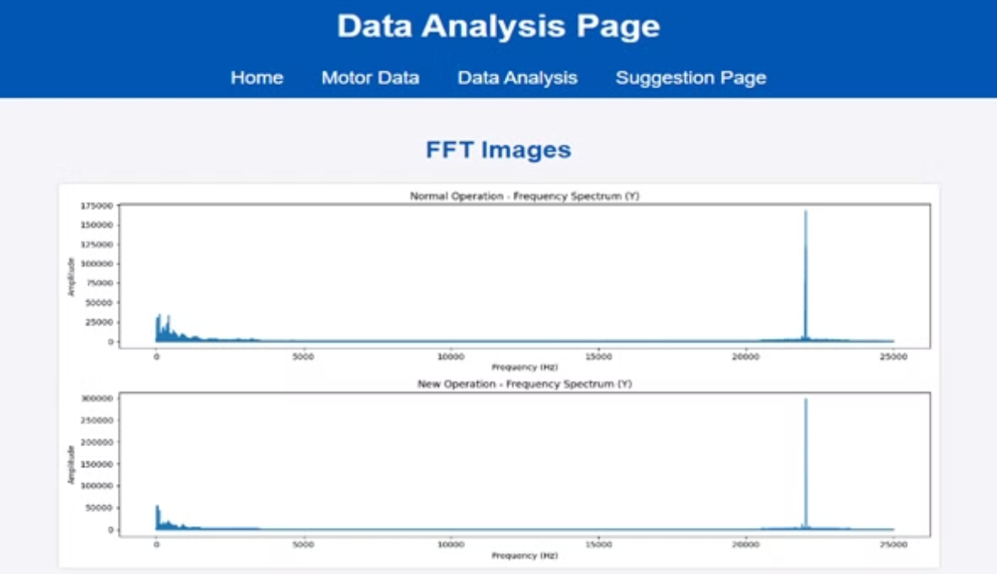
Website Data Analysis Page
This page displays the results of the data analytics to show when a fault has occurred.
It is periodically changed with the new data coming to the system.

Slide 30
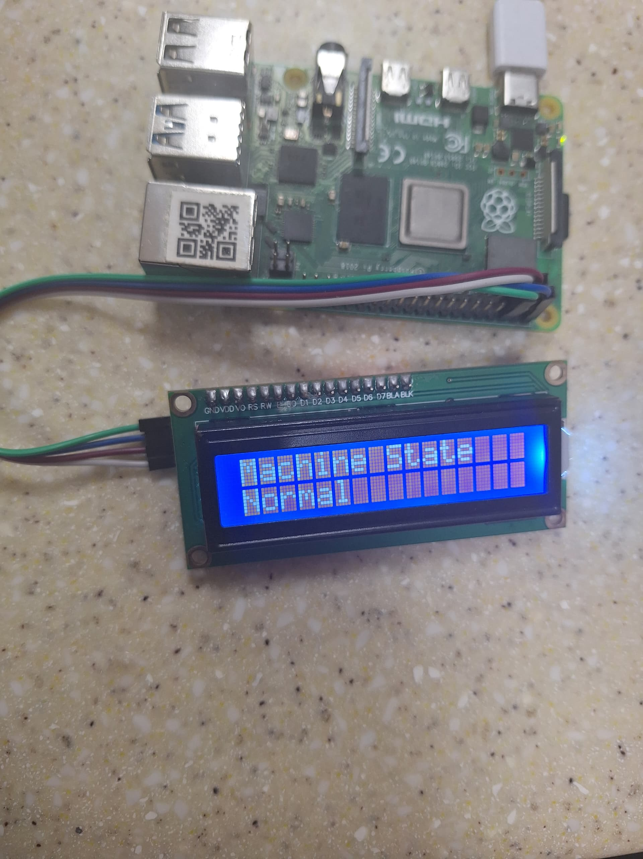
Raspberry Pi Setup
This is a simple setup to exhibit the results of the data processing.
The state of the overall system is showed on the lcd screen.
When faults occur then the screen shows which motor is at fault.

Slide 31
Conclusion and Future Works
The multi-sensor module designed was able to collect and transmit data that was successfully labeled and process to identify faults using FFTs and Machine Learning
In future works the machine learning model can be further developed to accurately detect all the types of faults.
In conclusion, the goal of this project was to develop a system that can monitor the condition of an induction motor and determine when faults occur.

Slide 32
Thank You

